Slide 1

Module 5: Using Command Line to Access the DAC Server
0/5
Analytics: Advanced Data Warehouse Developer
Notes:
Time: Lecture: 15 – 20 minutes; Labs: 25 – 30 minutes
Intent: To setup and use command line access to the DAC server
Flow: Describe the business needs to access the DAC server without the DAC client; review steps to setup command line access to the DAC server; show methods and examples to use command line access to the DAC server
Key Terms:
DAC Server
DAC Client
Command Line
DAC Command
Methods
5

Slide 2
Module Objectives
After completing this module you will be able to:
  Setup command line access to the Data Warehouse Application (DAC) server
  Use the command line to access the DAC server
Why you need to know:
  Using the command line allows you to access the DAC server without the DAC client
Notes:
Each objective and “why you need to know” should be stated aloud.

Slide 3
Business Problem
Run execution plans without using the DAC client
Integrate and manage extraction, transformation, and loading (ETL) with other business-critical and enterprise-wide applications using third-party administration or management tools
Notes:
A common business challenge is to schedule ETL using a enterprise-wide job management or scheduler application such as Unicenter Autosys from Computer Associates.
5

Slide 4
Business Solution: Command Line Access
Allows you to access the DAC server without the DAC client to perform the following:
  Start and stop execution plans
  Get status information for Informatica servers, databases, and execution plans
  Access the DAC server using third-party administration or management tools
Notes:
This solution still requires to perform the following on the machine from where the DAC server can be accessed using the command line option:
installing Java SDK (Software Development Kit)
copying DAC batch and executable files from the DAC server to the remote machine

Slide 5
Setting Up Command Line Access—Steps
0/3
1. Install Java Software Development Kit (SDK)
2. Copy the Command Line Files
3. Configure the Command Line Files
Notes:
This is a structuring slide. Do not teach the steps or concepts here because the following slides cover them in detail.
5

Slide 6
1. Install Java Software Development Kit (SDK)
1/3
Install Java Software Development Kit (SDK) 1.4.2 on the remote machine from where the DAC server will be accessed
  The Java SDK version on the remote machine and the DAC server need to be the same
Notes:
The Java SDK is part of J2SE (Java 2, Standard Edition) which provides an application development environment.
More information on Java SDK is available at http://java.sun.com. It can be downloaded from this site.

Slide 7
2. Copy the Command Line Files
2/3
Copy the following files from SiebelAnalytics\DAC directory on the DAC server to the local directory on the remote machine
  DAWSystem.jar
  dac.properties
  dacCmdLine.bat
Notes:
This slide lists the command line files that need to be copied to the remote machine.
5

Slide 8
3. Configure the Command Line Files
3/3
Edit the parameter values in the following files:
  dacCmdLine.bat
  dac.properties
Notes:
This is a positioning slide. Each item is covered in following slides.

Slide 9

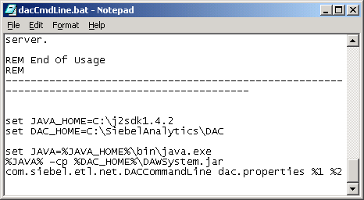
3. Configure the Command Line Files Continued
3/3
Edit the following parameters in the dacCmdLine.bat file:
  JAVA_HOME – Points to the directory where the Java SDK is installed
  DAC_HOME – Points to the directory where the DAC server is installed
Notes:
This slides describes the parameters that need to be edited in the dacCmdLine.bat file.
5

Slide 10
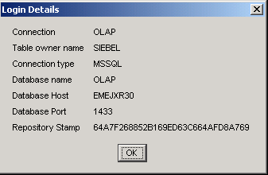
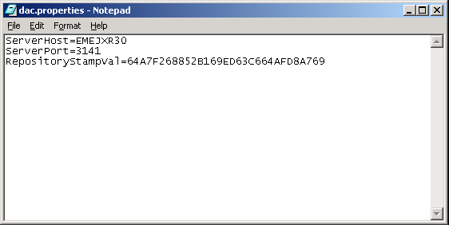
3. Configure the Command Line Files Continued
3/3
Edit the following parameters in the dac.properties file:
  ServerHost – Host name of the DAC Server
  ServerPort – Port of the DAC Server (default is 3141)
  RepositoryStampVal – Repository stamp that appears in the DAC client Login Details screen
    Navigate to Help > Login Details in the DAC client
Notes:
This slides describes the parameters that need to be edited in the dac.properties file.

Slide 11
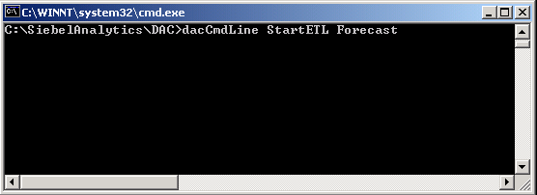
Using the Command Line
Use the following syntax at the command prompt to access the DAC server
  dacCmdLine <method name> <optional execution plan name>
For example:
  dacCmdLine StartETL Forecast – starts the Forecast execution plan
  dacCmdLine InformaticaStatus – returns the health status of all the Informatica servers defined in the DAC repository
Command
Method name
Execution name
Notes:
This slide describes the command line syntax to access the DAC server.
5

Slide 12
Using the Command Line Continued
Choose one of the following methods when invoking the command line option:
Method Name | Description
StartETL | Starts an execution plan. The execution plan name needs to be specified.
StopETL | Stops an execution plan. The execution plan name needs to be specified.
ETLStatus | Returns the status of an execution plan. If execution name unspecified, returns the status of the execution plan last ran.
DatabaseStatus | Verifies whether the DAC server can connect to all active database connections.
InformaticaStatus | Verifies whether the DAC server can connect to all active Informatica servers.
Notes:
The slide lists the available methods when invoking the command line option.

Slide 13
Summary
This module showed you how to:
  Setup command line access to the Data Warehouse Application (DAC) server
  Use the command line to access the DAC server
Notes:
This slide presents a summary of the topics covered in the module.
5

Slide 14
Lab
In the lab you will:
  Perform steps to setup command line access to the DAC server
  Perform steps to use the command line to access the DAC server
Notes:
Labs and Troubleshooting:
In this lab, students are asked to setup and use the command line access to the DAC server.

